Slide 1
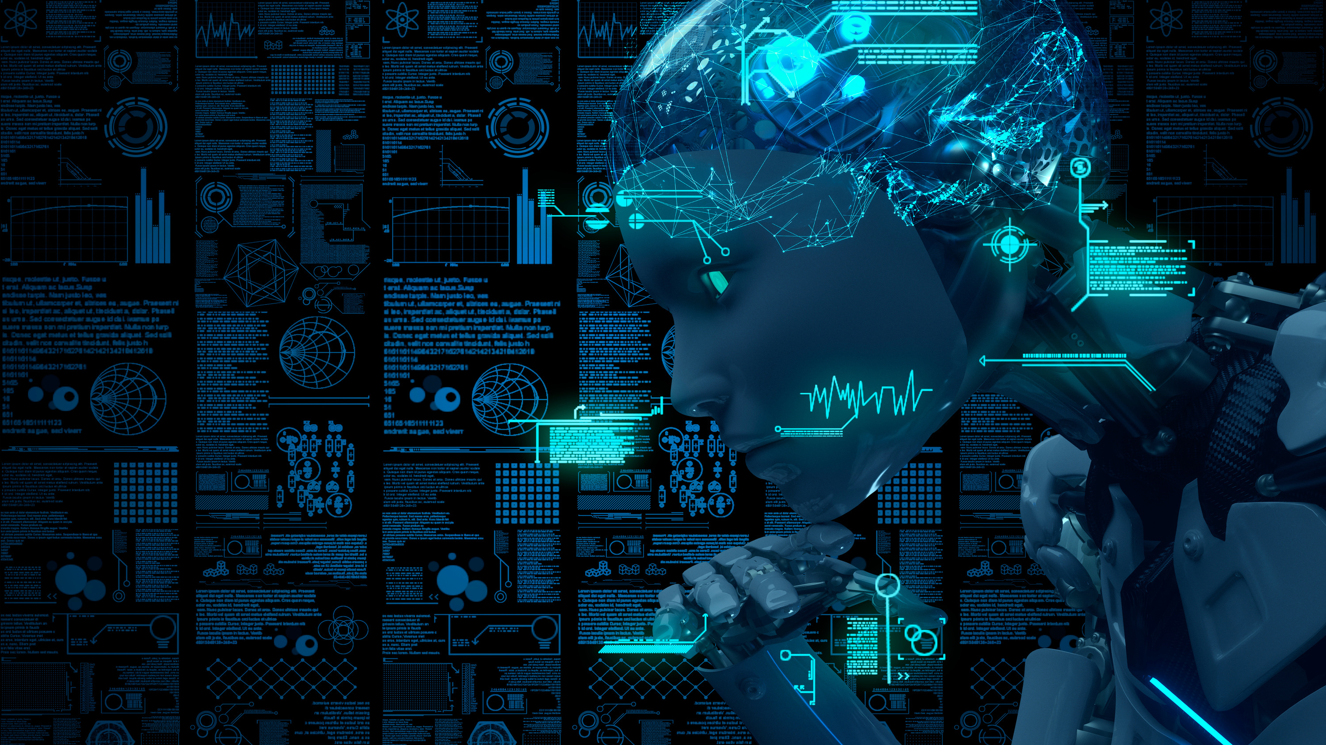

Internet of
Things

Slide 2
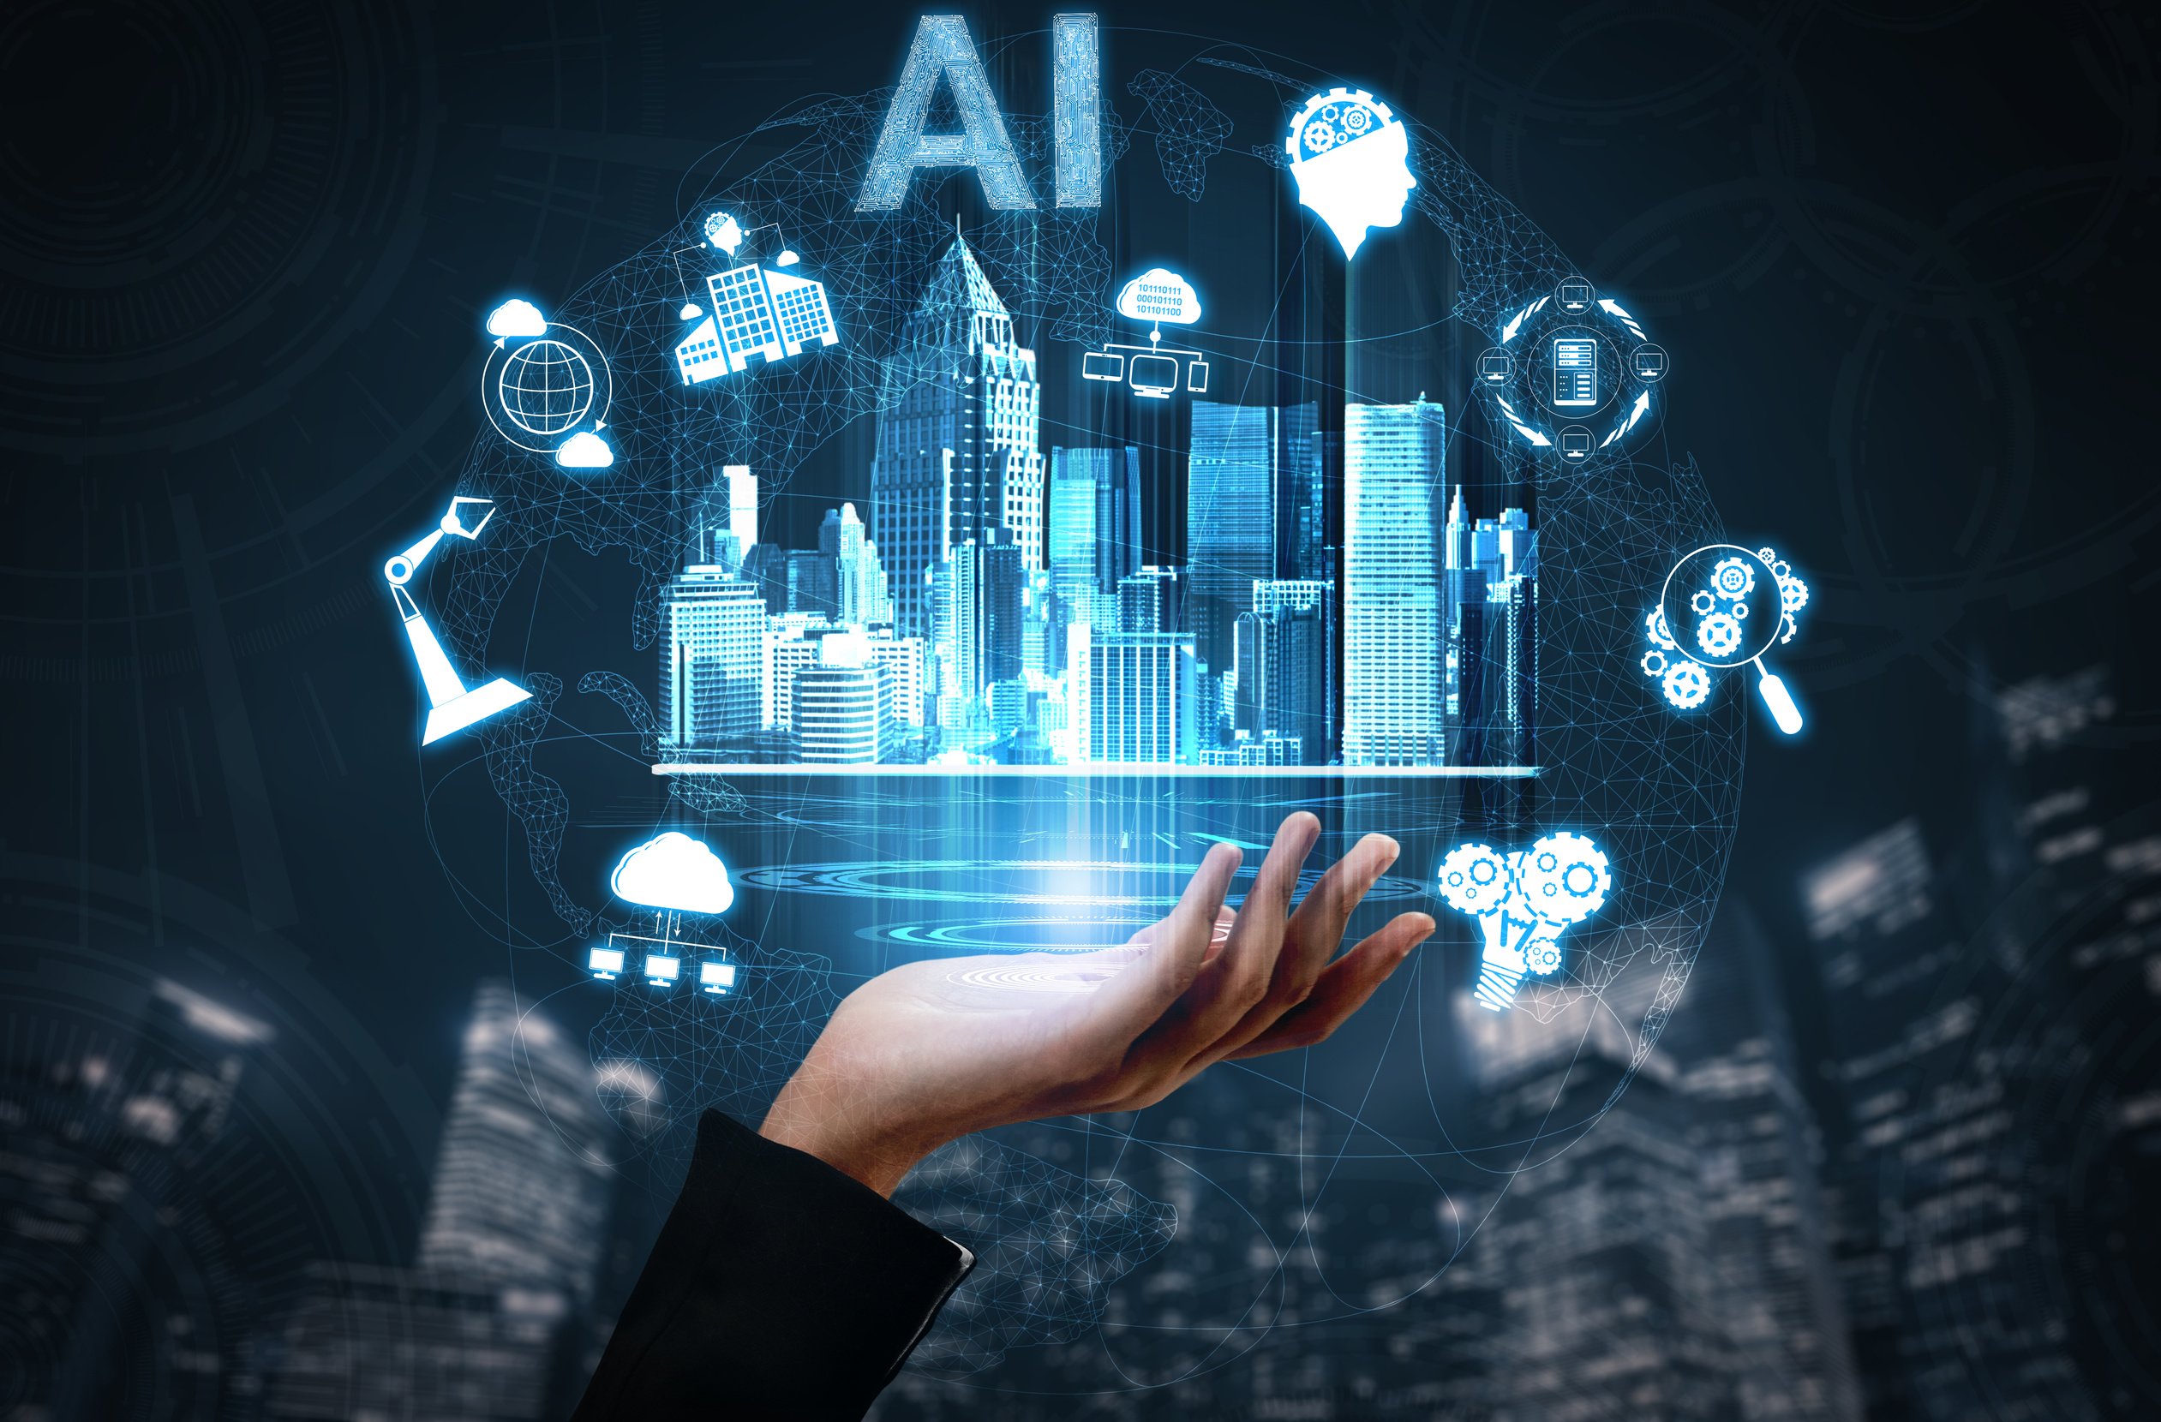
What is IoT?
it refers to the interconnection of physical devices, such as appliances and vehicles, that are embedded with software, sensors, and connectivity which enables these objects to connect and exchange data.
This connectivity which enables these objects to connect and exchange data. technology allows for the collection and sharing of data from a vast network of devices, creating opportunities for more efficient and automated systems.

Slide 3
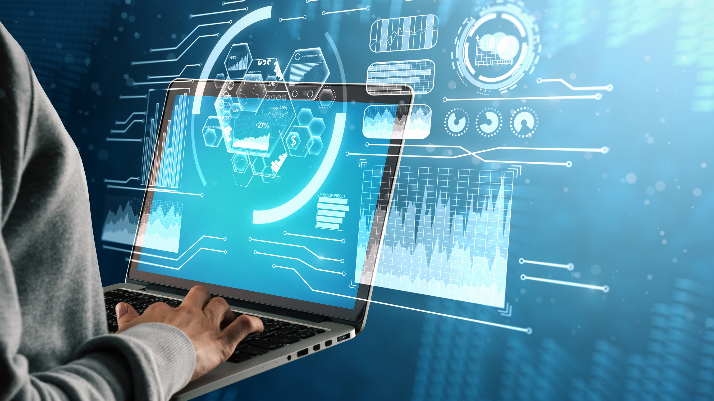
THE HISTORY OF
INTERNET OF THINGS
(IoT)

Slide 4
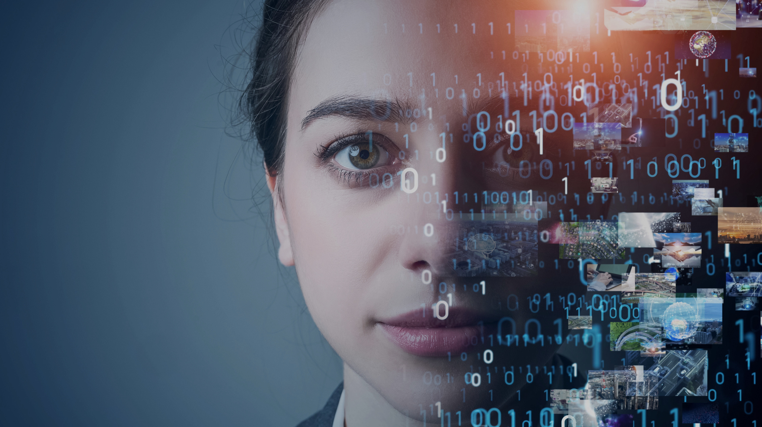
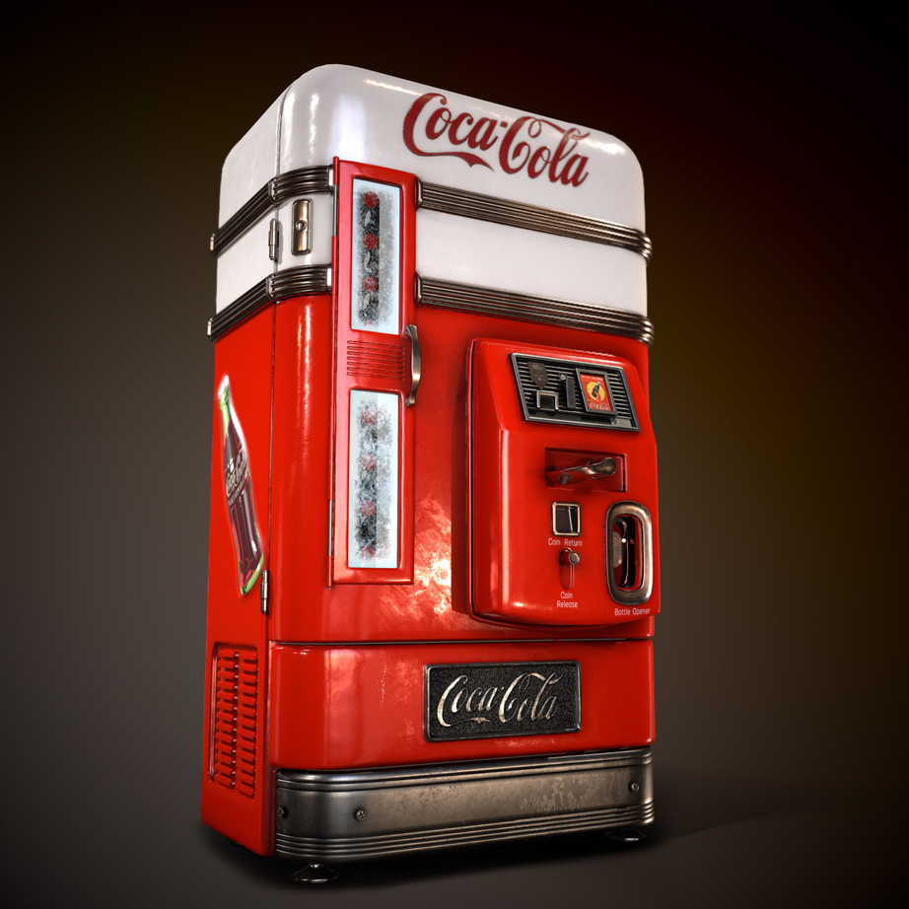
Predecessors to IoT
(1980s - 1990s)
The term "Internet of Things" was coined by Kevin Ashton in 1999, but the idea had roots in earlier developments.
In the 1980s and 1990s, researchers began exploring the concept of embedding sensors and connectivity into objects. For example, a Coca-Cola vending machine at Carnegie Mellon University was connected to the internet in 1982 to monitor inventory and temperature.

Slide 5
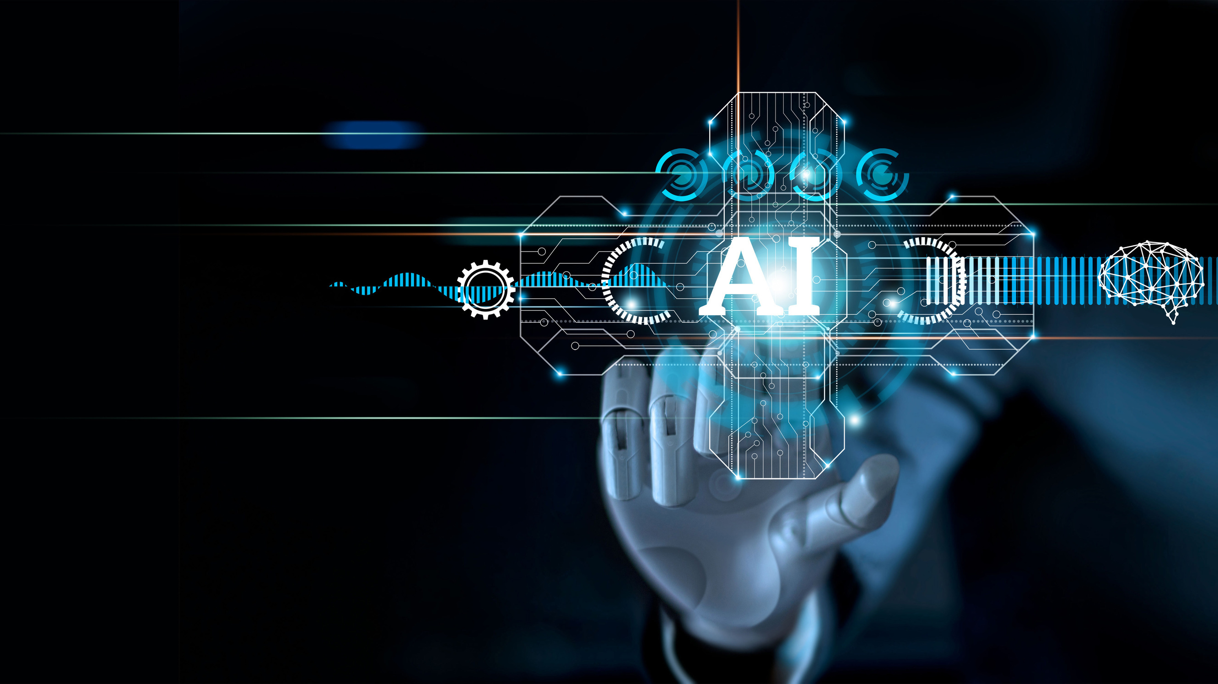
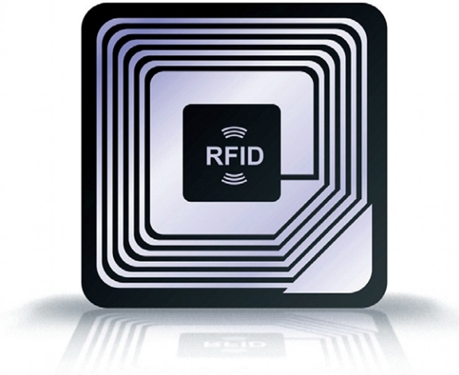
The Early 2000s
Kevin Ashton (the guy who came up with the name “Internet of Things”) believed Radio Frequency Identification (RFID) was a prerequisite for the Internet of Things — primarily as an inventory tracking solution.
In 2002-2003, Walmart and the US Department of Defense were the first large organizations to embrace Ashton’s model of tracking inventory using tagging, RFID, and the Internet of Things.

Slide 6
The Early 2000s
The Ring doorbell was developed in 2011 by Jamie Siminoff because he wanted to see who was at his door while he was in the garage, working. He couldn’t hear the doorbell from the garage and kept missing deliveries.

Slide 7
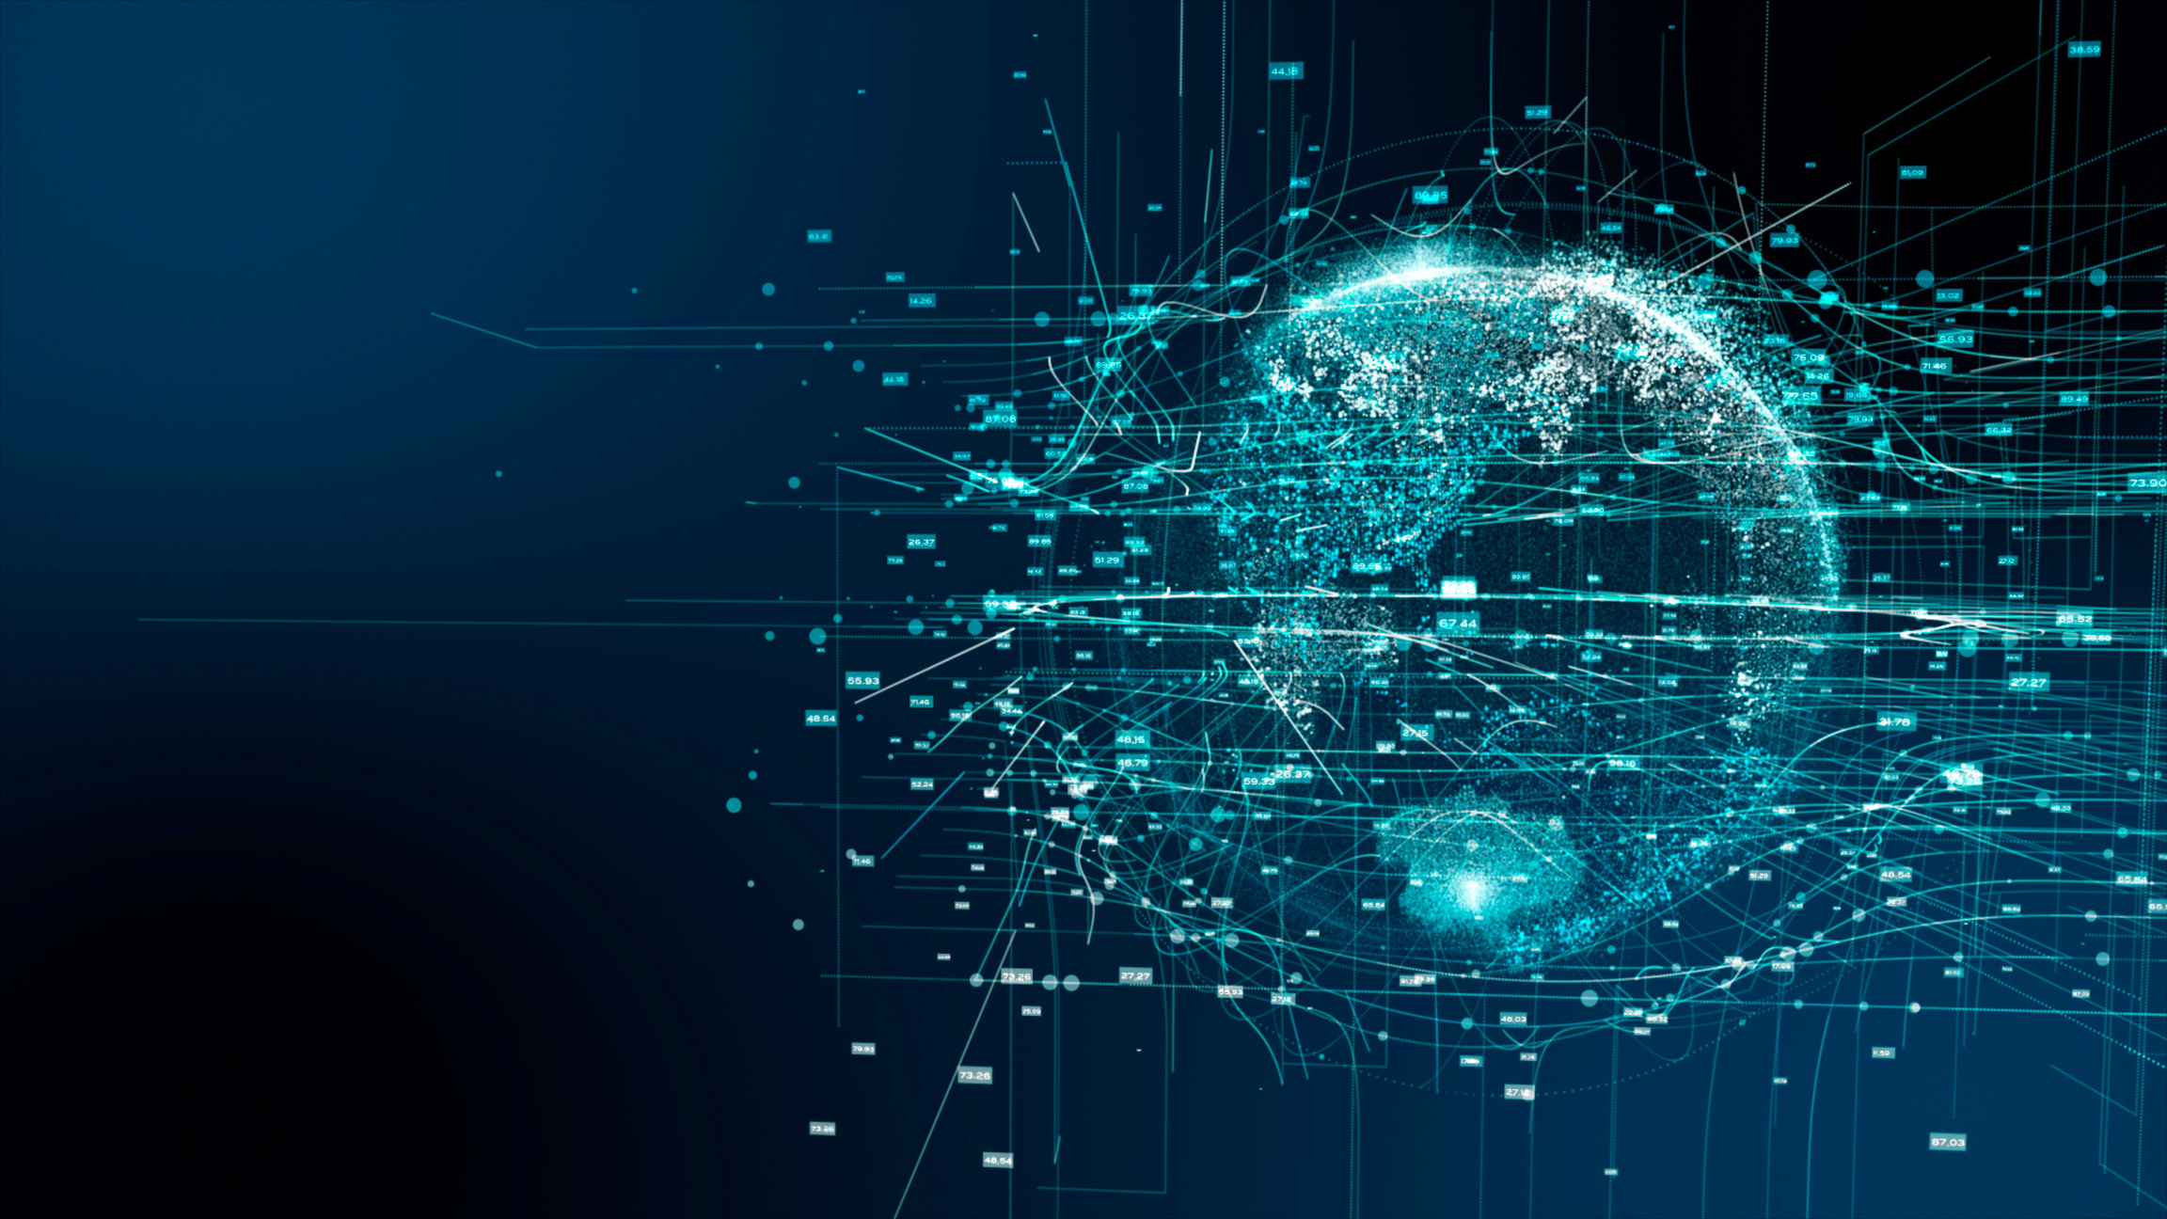
IoT Getting Smarter
“Smart cities” can use the IoT to reduce waste and maximize the efficient use of energy. The IoT can also be used to streamline traffic flows and locate available parking.
In 2012, The Swiss Federal Office of Energy started a pilot program called “Smart City Switzerland.” They brought representatives from universities, business, and public administration together to discuss new ideas for the urban environment. Smart City Switzerland has over sixty projects underway and supports new scientific partnerships and innovation. (Smart City Switzerland has evolved into something quite impressive.)

Slide 8
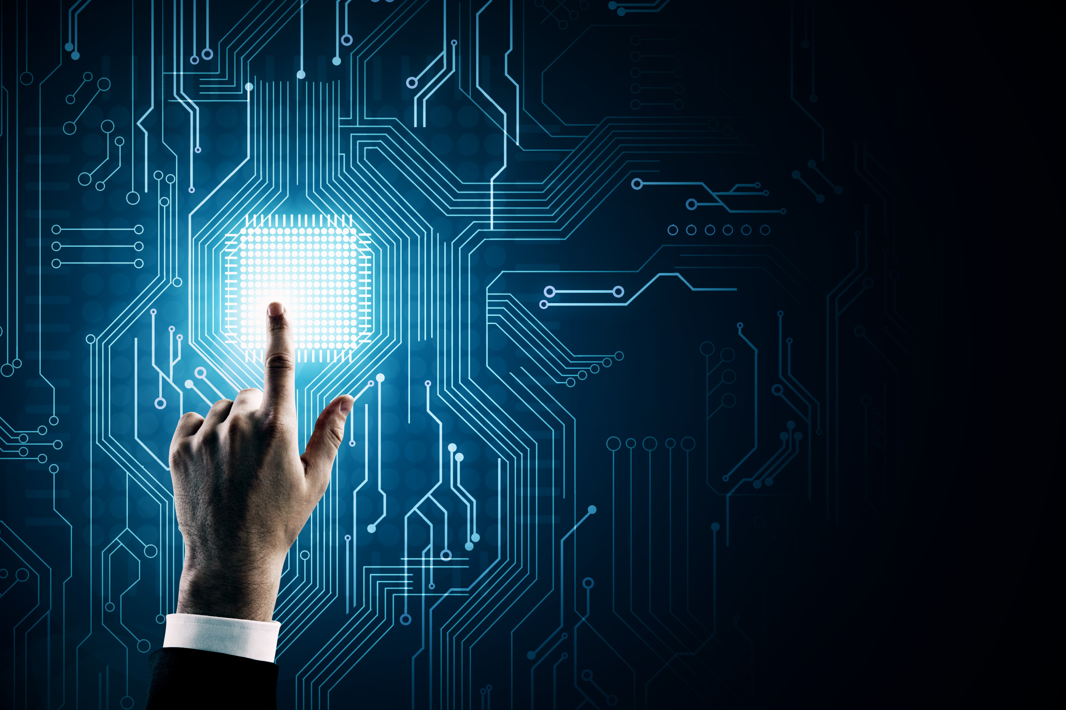
The Industrial Internet of Things (IIoT)
The Industrial Internet of Things (IIoT) is an extension of the IoT, and uses actuators and smart sensors, which are networked together with a company’s industrial applications. The goal is to give industries greater efficiency and reliability. The IIoT includes robotics and software-defined production processes.

Slide 9
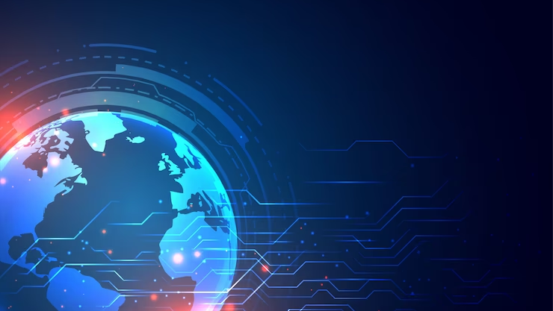
The Internet of Things Becomes a Part of Life
By the year 2013, the IoT had become a system using multiple technologies, ranging from the Internet to wireless communication and from micro-electromechanical systems (MEMS) to embedded systems.
Heart Monitor Implant
Biochip Transponder

Slide 10
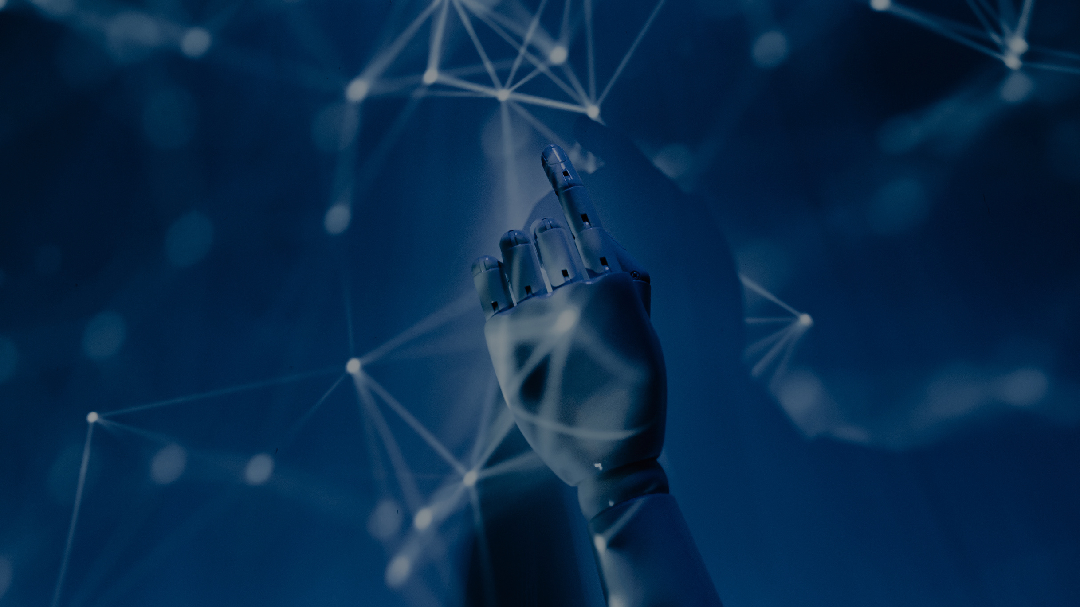
The IoT Goes Mobile – 2015
Smartphones are part of the IoT, and have become an important communications tool for many individuals.
The healthcare industry has also taken advantage of this trend.
Cars and trucks are already loaded with sensors and technology, including OBD (on-board diagnostics) and GPS.
Self-driving cars are new members of the IOT.

Slide 11
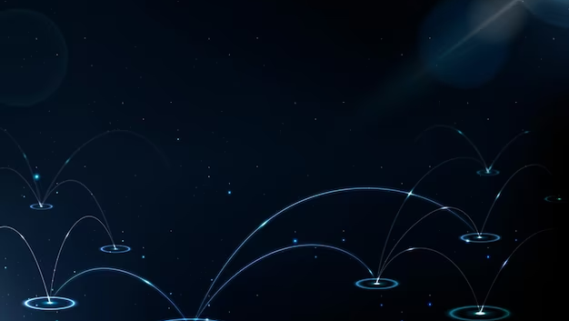
PROS AND CONS OF IOT

Slide 12

PROS AND CONS OF IOT
PROS
Easy to Access
Increased Efficiency
Improved Quality of Life
Increased Safety and Security
Greater Convenience
Improved Communication
Reduced Costs
CONS
Security Issues
Privacy Issues
Dependence
High costs
Complexity

Slide 13
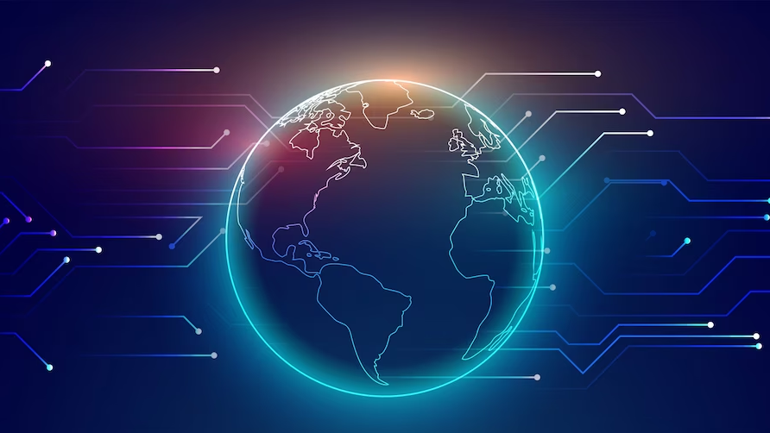
COMPONENTS OF IOT

Slide 14
4 Components of IOT
Sensors
Connectivity
Data processing
User Interface

Slide 15
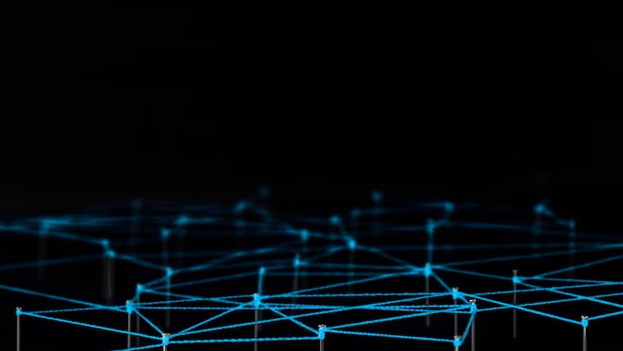
Sensors
These devices connect with the external physical environment. They collect the data from the outside changes and store this information. A sensor senses the changes in the surroundings and notes down these changes. This property makes sensors extremely useful in IoT applications.

Slide 16
2. Connectivity
Cloud servers process the data that sensors collect. Connectivity is the connection among all IoT devices in any given Iot ecosystem including sensors, routers, gateways, user applications and platforms.

Slide 17
3. Data Processing
Once the entire data transmits to the platform, functions are performed on this data in order to process the data and send back necessary outputs.

Slide 18
4. User Interface
This stage is in direct contact with the user and it gives the output that users see on their screen. Every IoT device has a different interface as each device has a different task or purpose to accomplish.

Slide 19
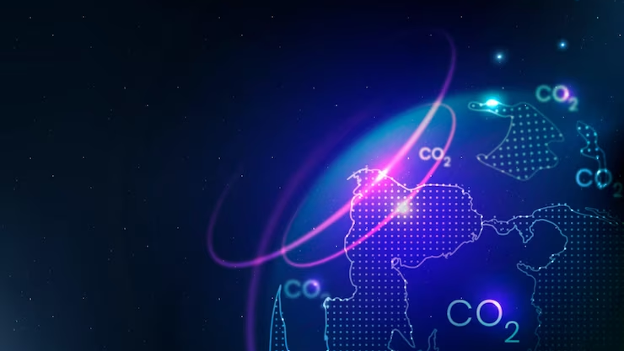
HOW IOT WORKS

Slide 20
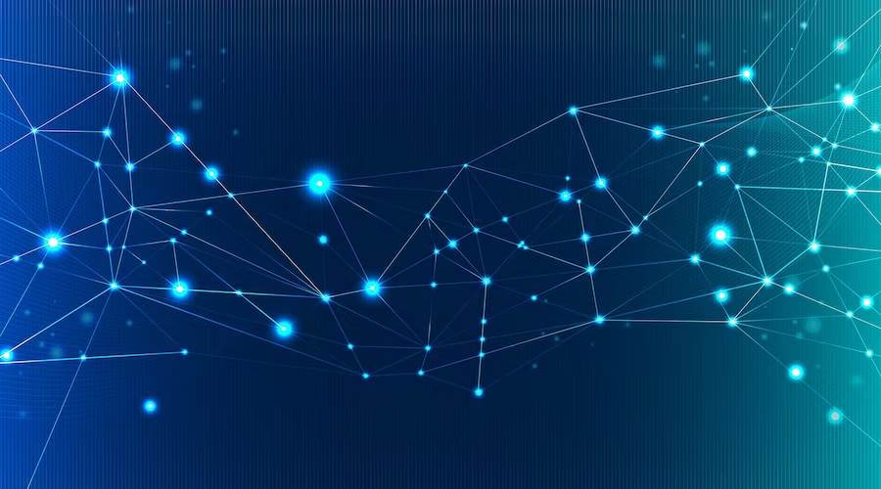
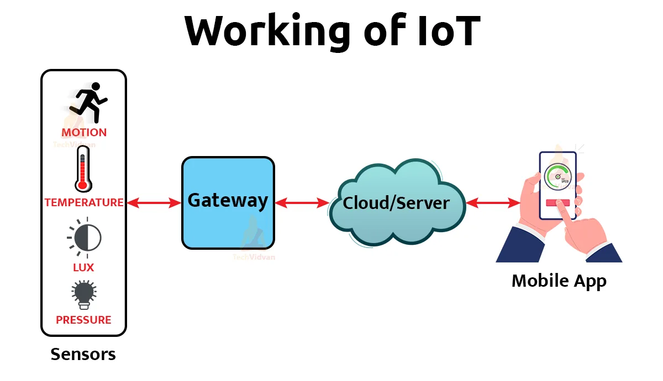

Slide 21
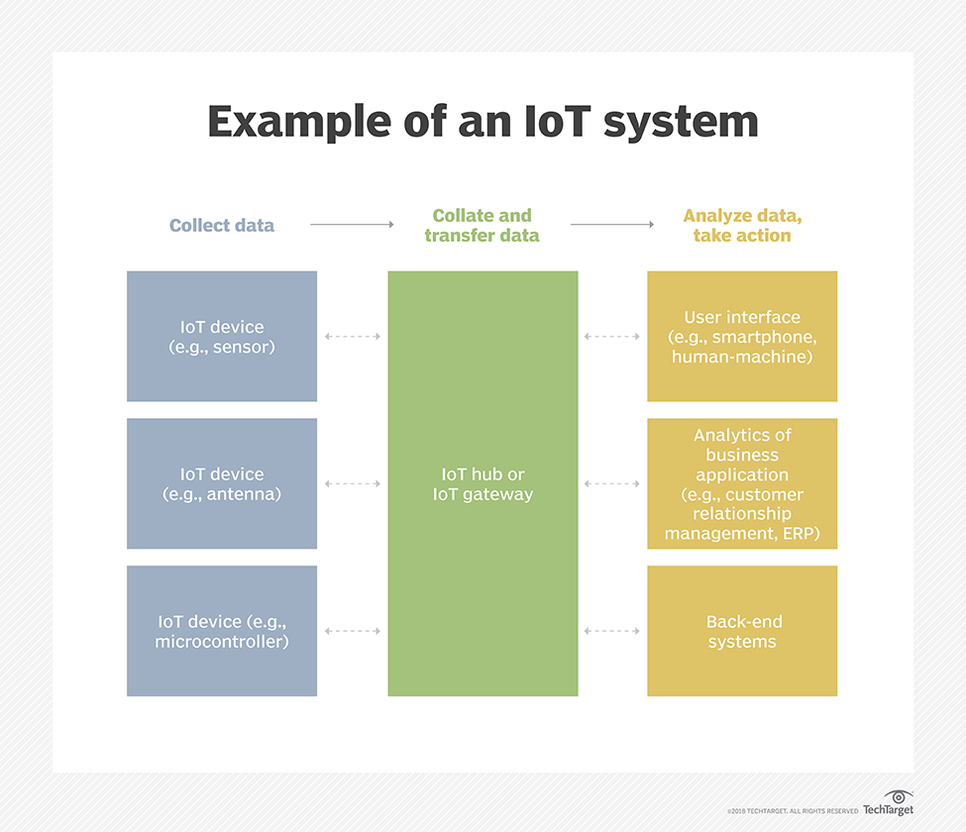

Slide 22
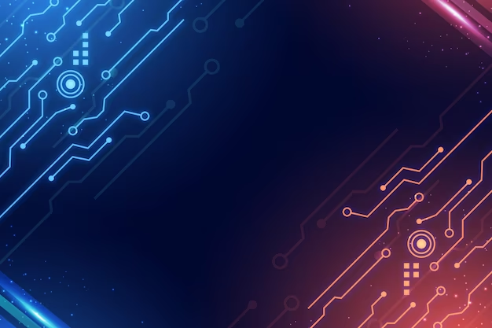


Slide 23
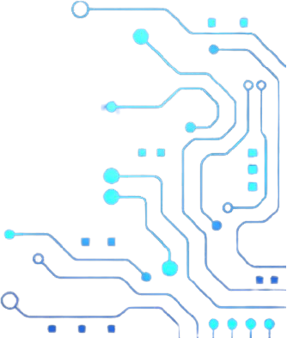

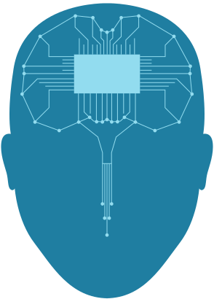


ARCHITECTURE
OF
IoT

Slide 24


Slide 25
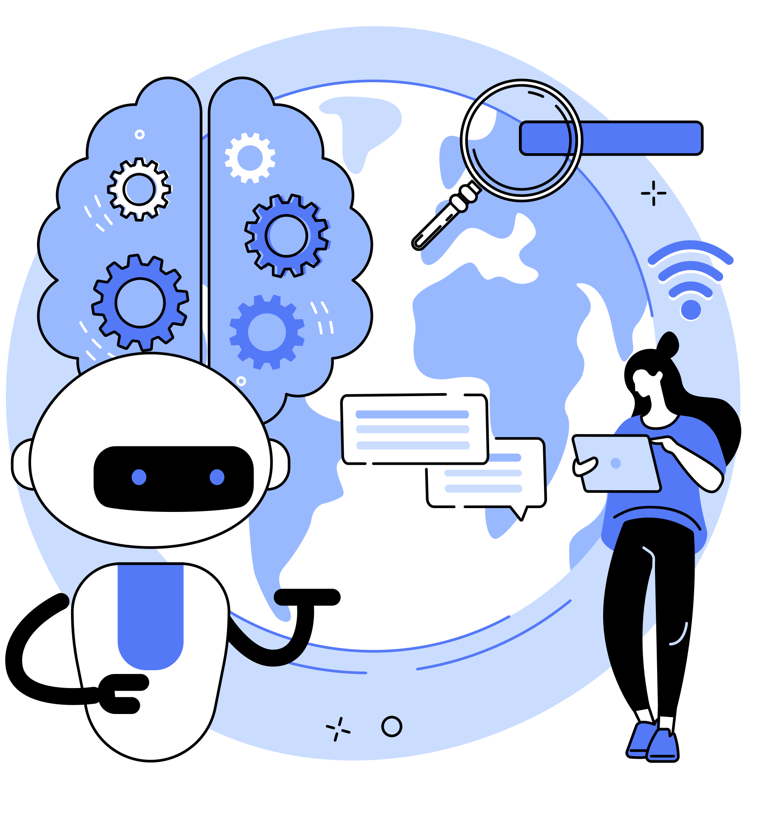
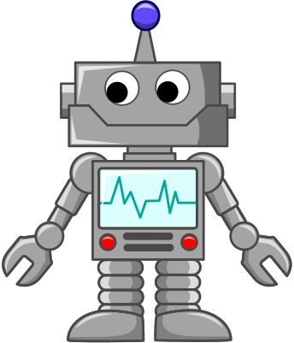
IoT ARCHITECTURE
IoT architecture is the structure enabling internet-connected devices to communicate with other devices.

Slide 26
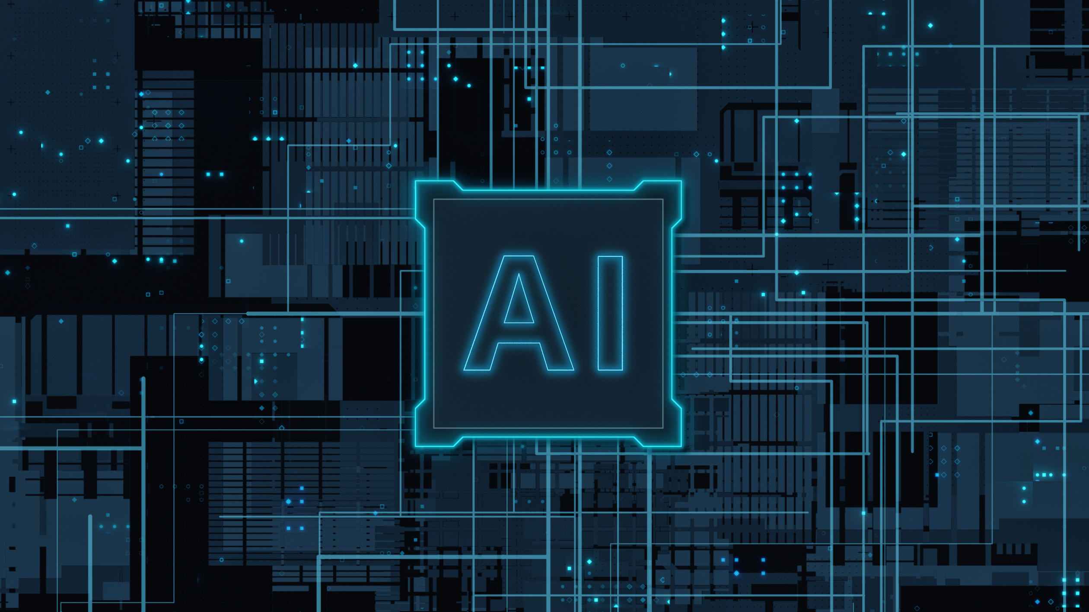
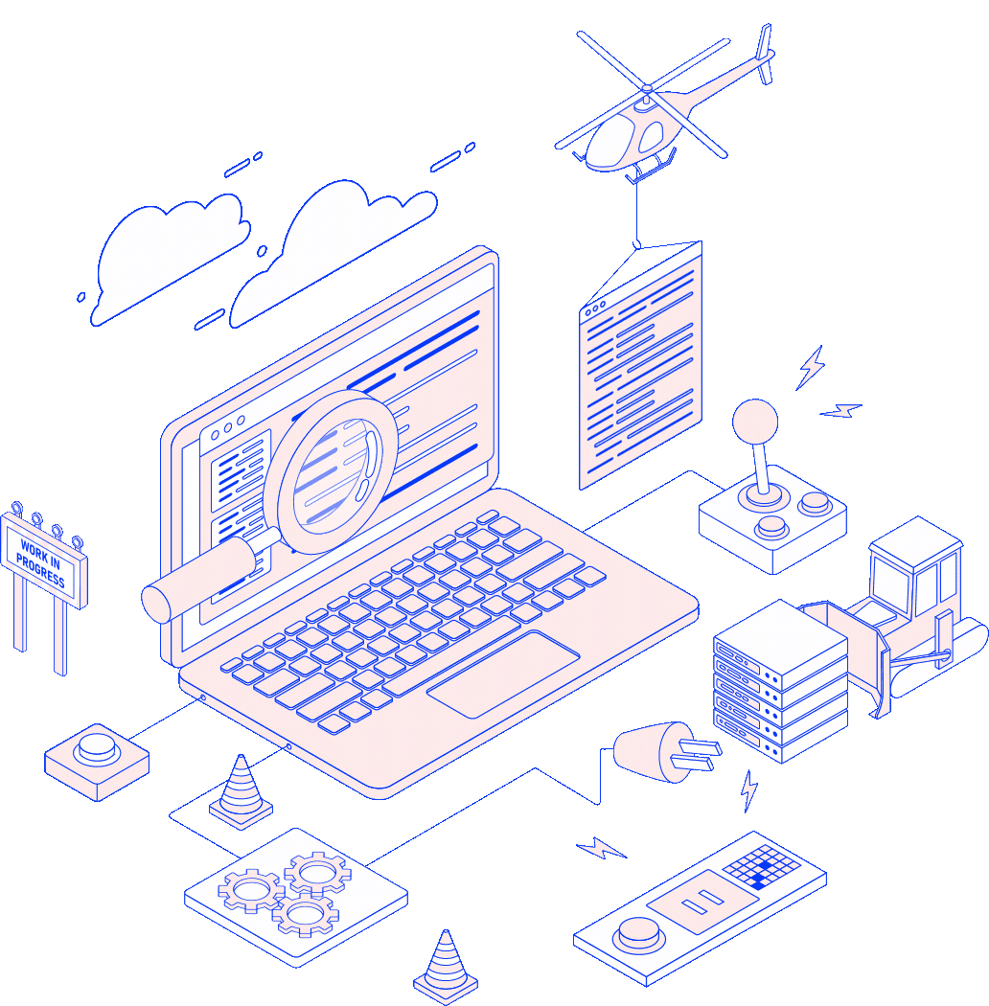

LAYERS OF
IoT ARCHITECTURE

Slide 27
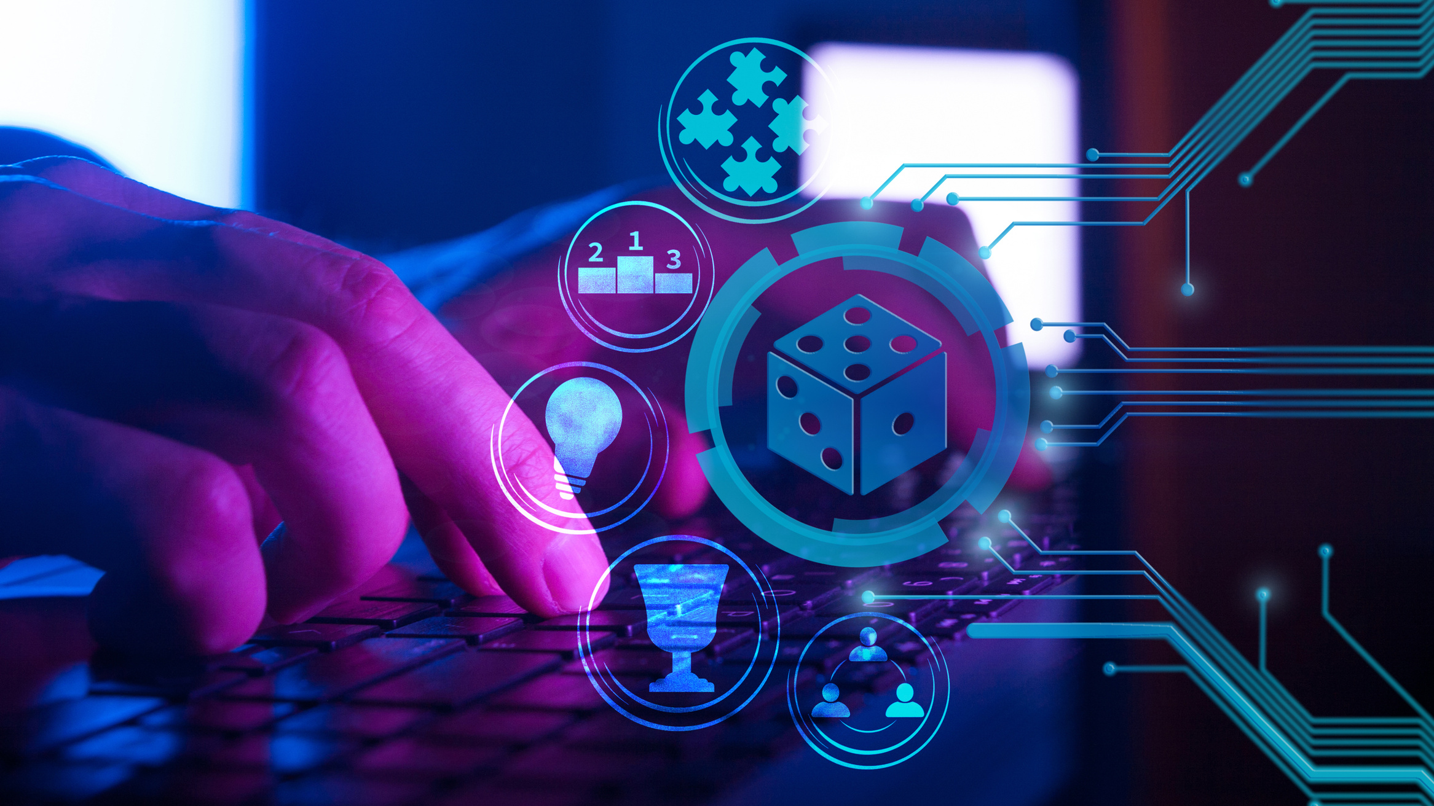
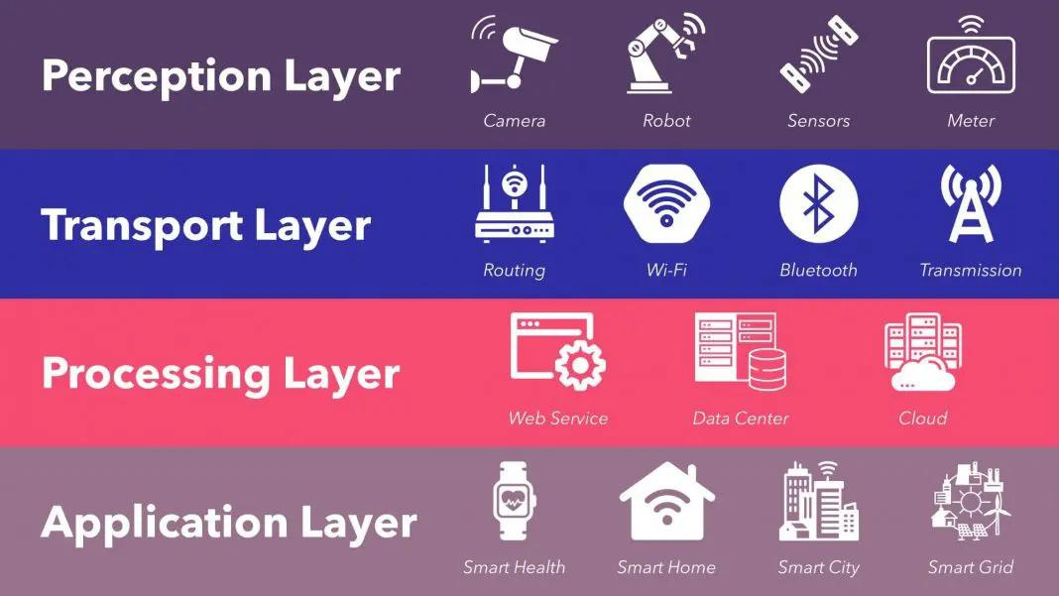
MAIN LAYERS OF IoT ARCHITECTURE

Slide 28


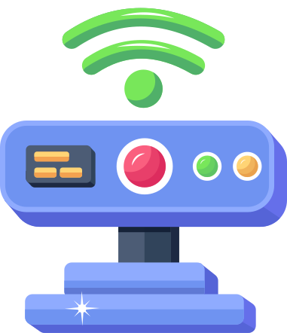


PERCEPTION LAYER
The perception layer is the bottommost layer of the IoT architecture and includes the physical devices or sensors that gather data from the surrounding environment. These devices can be various sensors, actuators, RFID tags, cameras, or any other sensing device capable of detecting and measuring different parameters like temperature, humidity, motion, light, etc.

Slide 29
NETWORK LAYER
The network layer facilitates the communication and connectivity between the devices in the IoT ecosystem. It consists of various networking technologies, protocols, and infrastructure components like routers, gateways, switches, and wireless networks (Wi-Fi, Bluetooth, Zigbee, cellular networks, etc.).

Slide 30
PROCESSING LAYER
A fundamental component of an IoT system architecture is its processing layer, also called the middleware layer, which typically leverages many connected computers simultaneously, in the form of cloud computing, to deliver superior compute, storage, networking, and security performance.

Slide 31
PROCESSING LAYER
An IoT system typically handles huge volumes of data, generated by numerous edge devices, at multiple sites on the edges of the network. The ‘middleware’ of the processing layer utilizes a three-stage approach to prepare this data for the application layer:
1. Data Accumulation: middleware correctly identifies and assigns different data types to the appropriate storage. Unstructured data, such as audio and video streams and images, typically require more storage space and are housed in data lakes. Whereas structured data, comprising instrument readings, log values, and measurements (telemetry data) are more space-efficient and are stored in data warehouses
2. Data Abstraction: involves aggregating data from multiple sources, as well as ensuring that data is converted into a format that can be “read” by the software of the application layer
3. Data Analysis: employs machine learning (ML) or deep learning algorithms, which are specialized in detecting patterns within large and seemingly random data sets

Slide 32
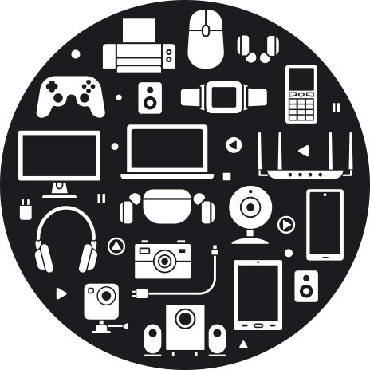
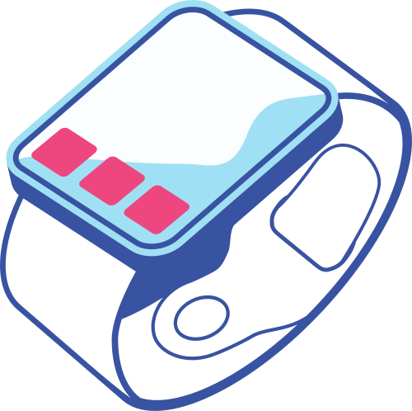
APPLICATION LAYER
The application layer focuses on processing and analyzing the data collected by the perception layer. It involves data storage, data management, and data processing components, such as cloud platforms, edge computing devices, and data analytics tools.

Slide 33

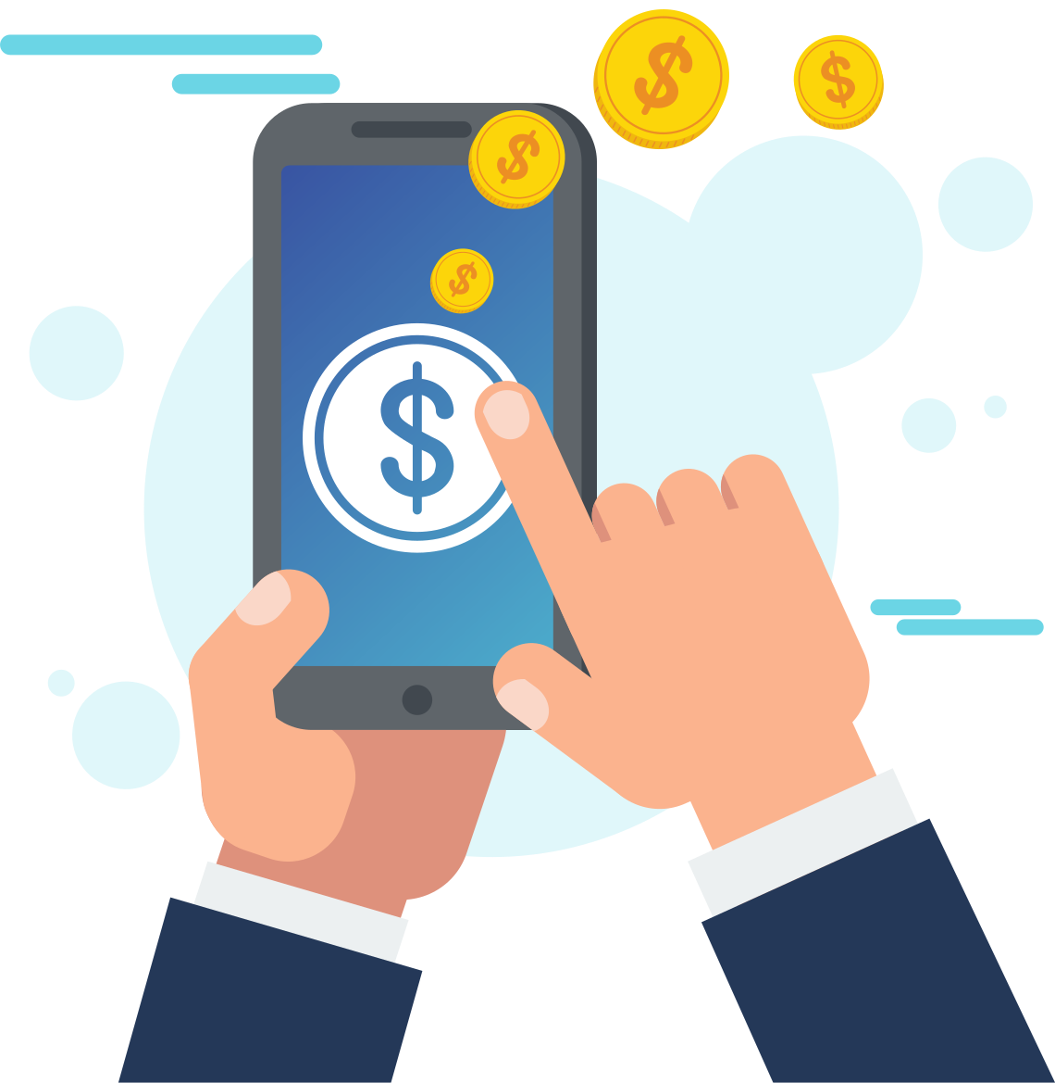
BUSINESS LAYER
Patterns decoded at the application level can be used to further distill business insights, project future trends, and drive operational decisions that improve the efficiency, safety, cost-effectiveness, customer experience, and other important aspects of business functionality. Indeed, all of this can be accomplished at the business layer of an IoT system architecture.

Slide 34



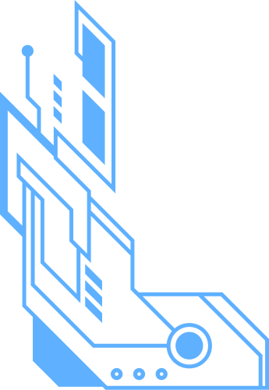
SECURITY LAYER
Security is one of the most important requirements for an IoT system architecture. Ironically, it also happens to be one of the key challenges facing IoT architecture, and IoT devices themselves. Broadly, the IoT security layer comprises three main aspects:
Equipment Security: involves the actual IoT devices, and protecting these endpoints from malware and hijacks
Cloud Security: with most IoT data being processed in the cloud, cloud security is crucial to prevent data leaks
Connection Security: focused on securing data transmitted across networks, primarily with encryption. The transport layer security (TLS) protocol is considered the benchmark for IoT connection security

Slide 35

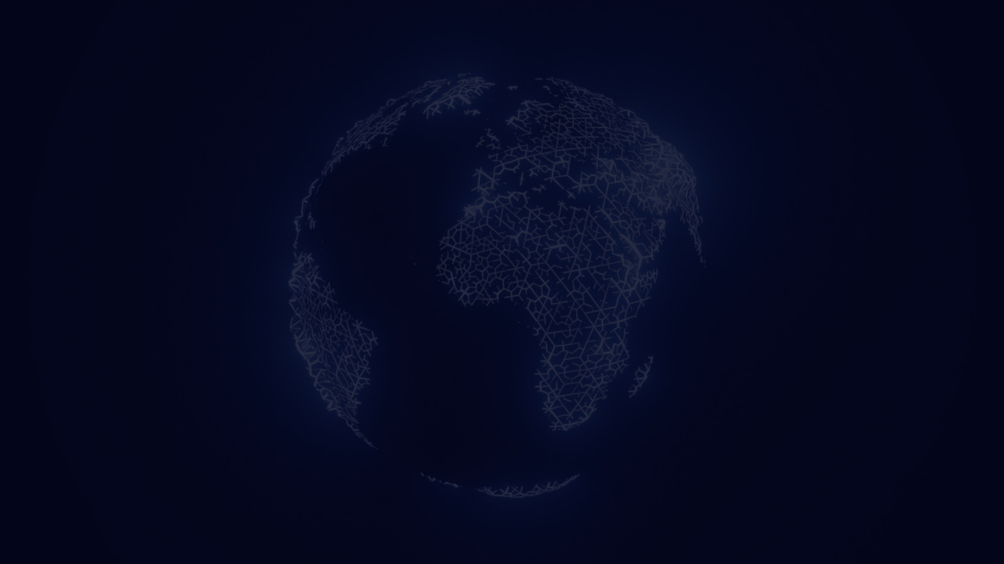

IoT
TOOLS AND PLATFORMS

Slide 36
What is IoT Tools and Platforms
IoT tools and platforms refer to software frameworks, development kits, and cloud-based services that facilitate the development, deployment, and management of Internet of Things (IoT) solutions. These tools and platforms provide a set of functionalities and services that help developers and organizations build, connect, monitor, and analyze IoT devices and data.

Slide 37
What is IoT Tools and Platforms
Software Development Kits (SDKs): SDKs provide libraries, APIs, and tools that enable developers to program IoT devices, create applications, and interact with IoT platforms. They often include device-specific features and protocols to simplify device integration.
Hardware Development Kits (HDKs): HDKs are physical kits that include development boards, sensors, actuators, and other components needed to build and prototype IoT devices. They often come with documentation, sample code, and reference designs.

Slide 38
What is IoT Tools and Platforms
3. Integrated Development Environments (IDEs): IDEs are software tools that provide a programming environment for writing, debugging, and testing code. IoT-specific IDEs often offer features tailored for IoT development, such as device simulation, code generation, and device management.
4. Connectivity Protocols: IoT tools may include support for various connectivity protocols like Wi-Fi, Bluetooth, Zigbee, LoRaWAN, cellular (3G, 4G, or 5G), and MQTT. These protocols allow IoT devices to communicate with each other and connect to cloud platforms.

Slide 39
What is IoT Tools and Platforms
5. Cloud Platforms: Cloud-based IoT platforms provide the infrastructure and services to manage and analyze IoT data. They offer features like device management, data storage, data analytics, real-time monitoring, security, and scalability. Developers can often use APIs and SDKs to integrate their devices and applications with the cloud platform.
6. Data Analytics and Visualization Tools: IoT platforms often provide tools for analyzing and visualizing the data generated by IoT devices. These tools help derive insights, detect patterns, and make data-driven decisions. They may include features like dashboards, reporting, machine learning, and predictive analytics.

Slide 40
What is IoT Tools and Platforms
7. Device Management Tools: IoT platforms typically offer device management capabilities that allow users to remotely monitor, configure, and update IoT devices. These tools help ensure the health, security, and performance of the deployed devices.
8. Security and Authentication: IoT tools and platforms include security features to protect IoT devices and data from unauthorized access, tampering, and other threats. These features may include authentication, encryption, secure communication protocols, and access control mechanisms.
9. Integration with Third-Party Services: Many IoT platforms provide integration with other services, APIs, and frameworks, enabling developers to connect their IoT solutions with external systems, databases, cloud services, or enterprise applications.

Slide 41
Application Areas of IoT

Slide 42
SMART HOME AND OFFICE AUTOMATION
Smart home applications with the use of smart sensors are becoming popular now. Any smart device can be configured and connected to the internet and controlled using a simple mobile application.

Slide 43



Search
> Smart Door Access and Control System
> Smart Lightning for Home and Office
> Automated Gate and Garage
> Smart Thermostats and Humidity Controllers
> Traffic Management
> Smart Lightning on Streets
> Pollution Monitoring and Reporting
>Smart Parking Solutions
>Water/Waste Management

Slide 44
WEARABLE TECHNOLOGY
Wearable smart devices were introduced as smart watches around a decade ago, and many more functions have been added since then. Now our smartwatches and wearables are capable of reading text messages, showing notifications of other apps, tracking location, monitoring workout status, reminding schedules, and continuously monitoring health conditions.

Slide 45
HEALTHCARE
The healthcare industry has been utilizing the possibilities of the Internet of Things for life-saving applications. Starting from collecting vital data from bedside devices, real-time diagnosing process, and accessing medical records and patient information across multiple departments, the entire patient care system can be improved with IoT implementation.

Slide 46
AUTONOMOUS DRIVING
Autonomous driving has been evolving with artificial intelligence and smart sensor technology in the Internet of Things. An earlier generation of autonomous vehicles (partial automation) will assist drivers in driving safely, avoiding collisions, and warning about road and vehicle conditions.

Slide 47
AGRICULTURE AND SMART FARMING
IoT devices can be employed in agriculture to monitor soil moisture, temperature, and nutrient levels, enabling precision farming and optimized irrigation. Connected sensors can also track livestock health, monitor crop growth, and automate feeding systems, leading to improved productivity and reduced resource waste.

Slide 48
Search
> Smart Irrigation
>Smart Greenhouse using Sensors
>Smart Farming

Slide 49
INDUSTRIAL IOT FOR MANUFACTURING
IoT is revolutionizing industries by enabling smart manufacturing processes, predictive maintenance, and supply chain optimization. Sensors embedded in machinery and equipment collect data, which is then used to improve efficiency, reduce downtime, and optimize resource allocation.

Slide 50
DISASTER MANAGEMENT
The Internet of Things, with a wide range of smart sensors, allows engineers to build a more effective emergency response system for factories, schools, hospitals, airports, and any other public gathering places. Any emergency situations like a fire outbreak or flooding will be automatically detected using sensors, and this information is shared with responsible work groups in real time.

Slide 51
LOGISTIC AND FLEET MANAGEMENT
The Internet of Things, with a wide range of smart sensors, allows engineers to build a more effective emergency response system for factories, schools, hospitals, airports, and any other public gathering places. Any emergency situations like a fire outbreak or flooding will be automatically detected using sensors, and this information is shared with responsible work groups in real time.

Slide 52
SMART GRIDS AND ENERGY MANAGEMENT
The smart grid concept is an enhancement of existing power grids with sensors deployed on the transmission lines and individual customer outlets. These sensors help to notify of any failure or abnormality in the line and understand the nature of usage and behavior patterns over time.

Slide 53
BIG DATA ANALYTICS
One of the basic components of big data analytics is the data itself; many organizations consider data as the most valuable asset to grow their business strategies. The source of data could be from anywhere, like machines, the environment, plants, people or even animals.

Slide 54
THANK YOU :)

